Slide 1
Design of Engineering Experiments
Blocking & Confounding in the 2^{k}
Text reference, Chapter 7
Blocking is a technique for dealing with controllable nuisance variables
Two cases are considered
  Replicated designs
  Unreplicated designs
Chapter 7
Design & Analysis of Experiments 8E 2012 Montgomery

Slide 2
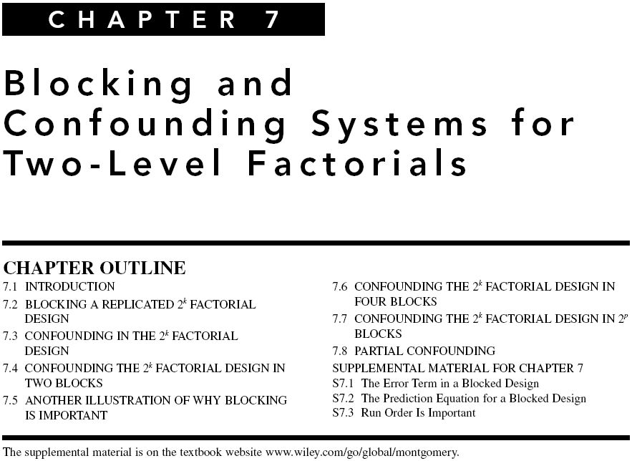

Chapter 7
Design & Analysis of Experiments 8E 2012 Montgomery

Slide 3
Blocking a Replicated Design
This is the same scenario discussed previously in Chapter 5
If there are n replicates of the design, then each replicate is a block
Each replicate is run in one of the blocks (time periods, batches of raw material, etc.)
Runs within the block are randomized
Chapter 7
Design & Analysis of Experiments 8E 2012 Montgomery

Slide 4
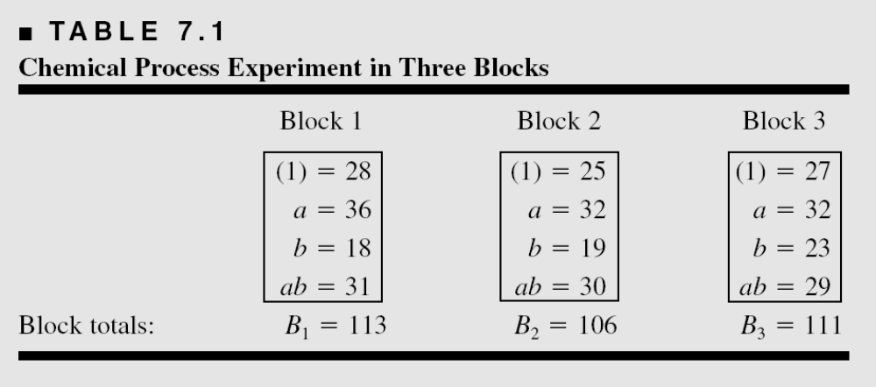
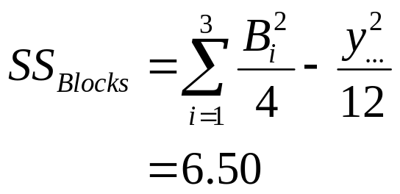
Blocking a Replicated Design
Consider the example from Section 6-2; k = 2 factors, n = 3 replicates
This is the “usual” method for calculating a block sum of squares
Chapter 7
Design & Analysis of Experiments 8E 2012 Montgomery

Slide 5
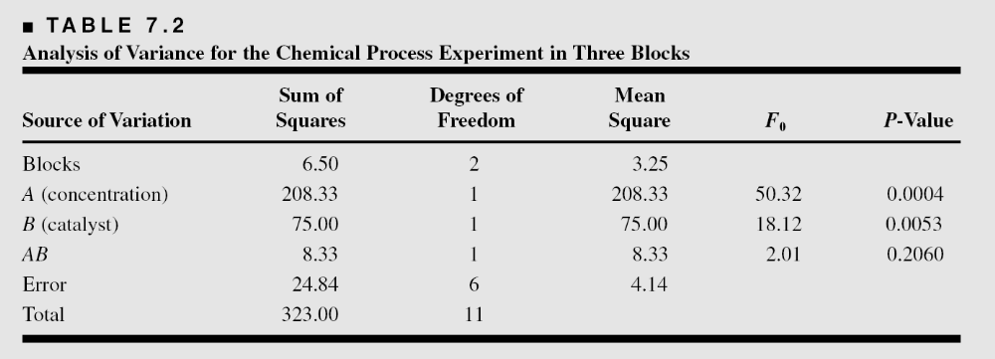
ANOVA for the Blocked Design
Page 305
Chapter 7
Design & Analysis of Experiments 8E 2012 Montgomery

Slide 6
Confounding in Blocks
Now consider the unreplicated case
Clearly the previous discussion does not apply, since there is only one replicate
To illustrate, consider the situation of Example 6.2, the resin plant experiment
This is a 2⁴, n = 1 replicate
Chapter 7
Design & Analysis of Experiments 8E 2012 Montgomery

Slide 7
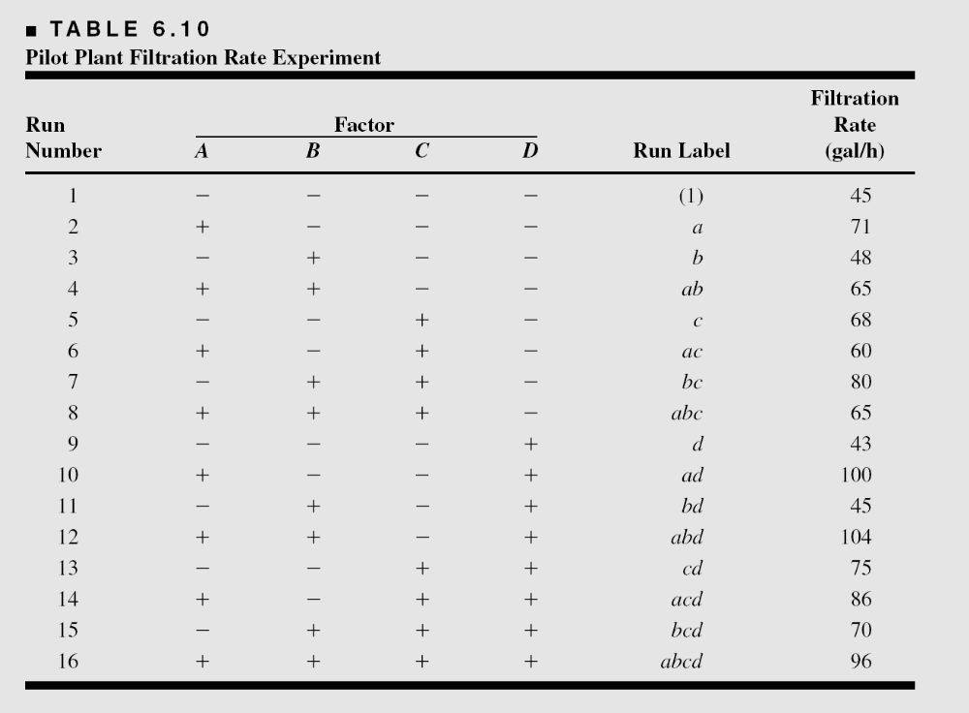
Experiment from Example 6.2
Suppose only 8 runs can be made from one batch of raw material
Chapter 7
Design & Analysis of Experiments 8E 2012 Montgomery

Slide 8
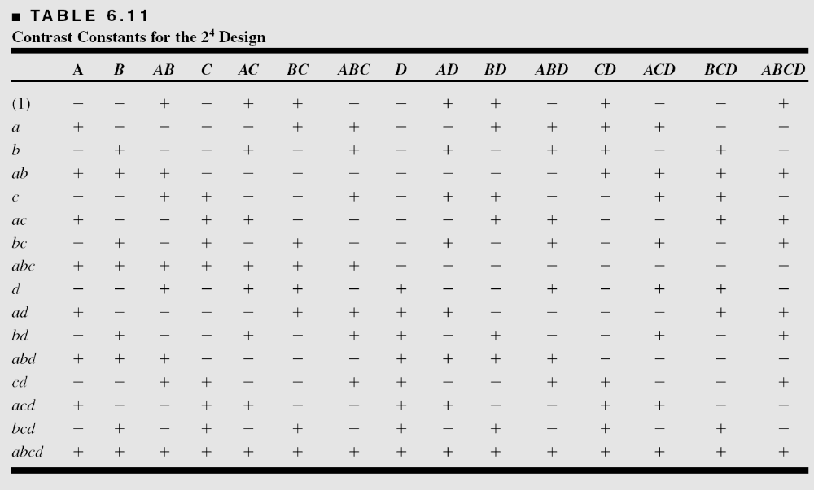
The Table of + & - Signs, Example 6-4
Chapter 7
Design & Analysis of Experiments 8E 2012 Montgomery

Slide 9
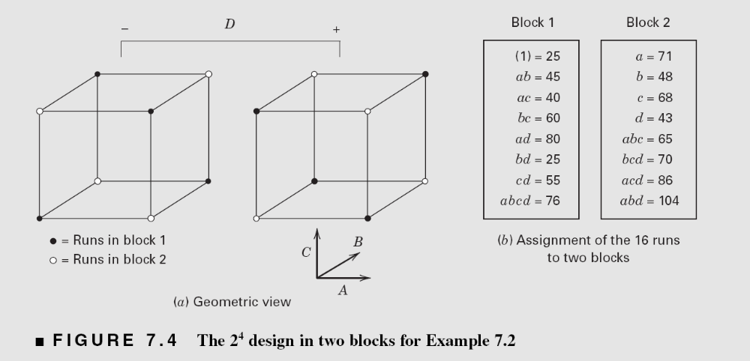
ABCD is Confounded with Blocks
(Page 310)
Observations in block 1 are reduced by 20 units…this is the simulated “block effect”
Chapter 7
Design & Analysis of Experiments 8E 2012 Montgomery

Slide 10
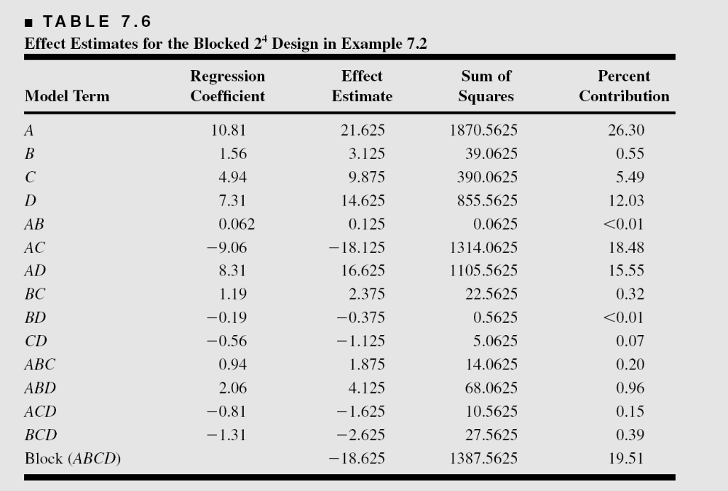
Effect Estimates
Chapter 7
Design & Analysis of Experiments 8E 2012 Montgomery

Slide 11
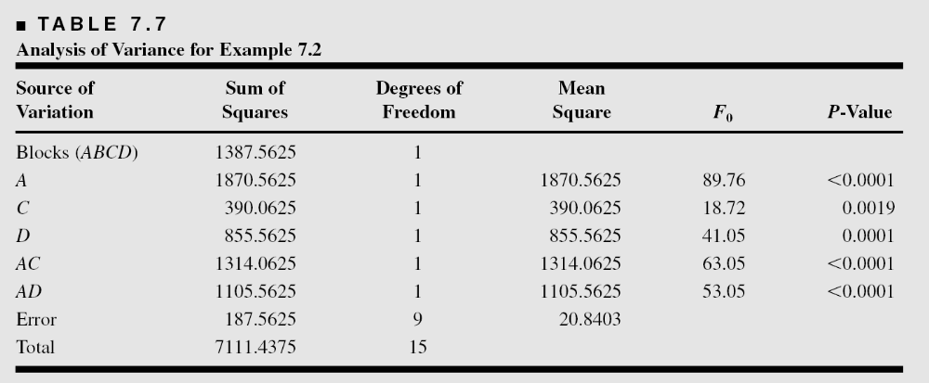
The ANOVA
The ABCD interaction (or the block effect) is not considered as part of the error term
The reset of the analysis is unchanged from the original analysis
Chapter 7
Design & Analysis of Experiments 8E 2012 Montgomery

Slide 12
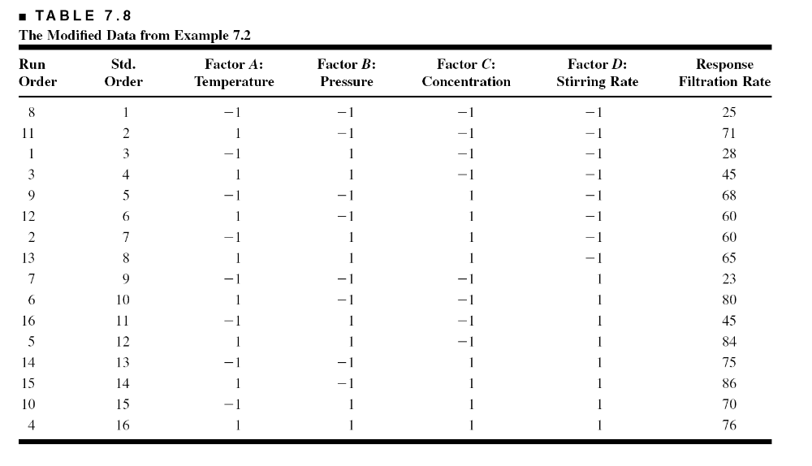
Another Illustration of the Importance of Blocking
Now the first eight runs (in run order) have filtration rate reduced by 20 units
Chapter 7
Design & Analysis of Experiments 8E 2012 Montgomery

Slide 13
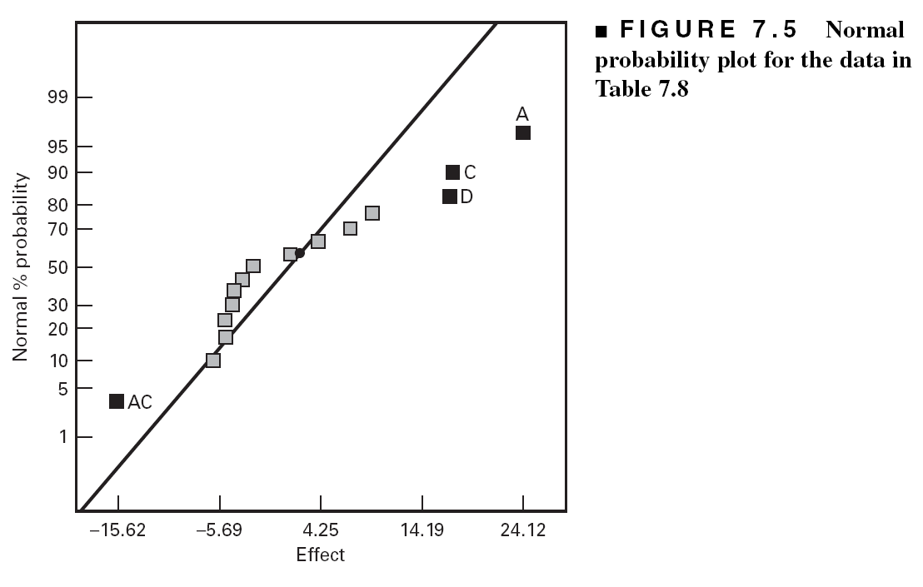
The interpretation is harder; not as easy to identify the large effects
One important interaction is not identified (AD)
Failing to block when we should have causes problems in interpretation the result of an experiment and can mask the presence of real factor effects
Chapter 7
Design & Analysis of Experiments 8E 2012 Montgomery

Slide 14
Confounding in Blocks
More than two blocks (page 313)
  The two-level factorial can be confounded in 2, 4, 8, … (2^{p}, p > 1) blocks
  For four blocks, select two effects to confound, automatically confounding a third effect
  See example, page 314
  Choice of confounding schemes non-trivial; see Table 7.9, page 316
Partial confounding (page 316)
Chapter 7
Design & Analysis of Experiments 8E 2012 Montgomery

Slide 15
General Advice About Blocking
When in doubt, block
Block out the nuisance variables you know about, randomize as much as possible and rely on randomization to help balance out unknown nuisance effects
Measure the nuisance factors you know about but can’t control (ANCOVA)
It may be a good idea to conduct the experiment in blocks even if there isn't an obvious nuisance factor, just to protect against the loss of data or situations where the complete experiment can’t be finished
Chapter 7
Design & Analysis of Experiments 8E 2012 Montgomery

